Slide 1
Interprocess Communication

Slide 2
Interprocess Communication
Processes executing concurrently in the operating system may be:
Independent
Cooperating
Independent process
if a process does not share data with any other processes executing in the system.
Cannot affect or be affected by the other processes executing in the system.
Cooperating process
Any process that shares data with other processes cooperating process.
Can affect or be affected by other processes executing in the system.

Slide 3
Interprocess Communication
Why process cooperation?
Information sharing
Since several applications may be interested in the same piece of information, we must provide an environment to allow concurrent access to such information.
Modularity
To construct the system in a modular fashion, dividing the system functions into separate processes or threads
Computation speedup
If we want a particular task to run faster, we must break it into subtasks, each of which will be executing in parallel with the others.

Slide 4
Interprocess Communication
Cooperating processes require an inter-process communication (IPC) mechanism that will allow them to exchange data
Send data to and
Receive data from each other
Two fundamental models of interprocess communication:
Shared memory
Message passing

Slide 5
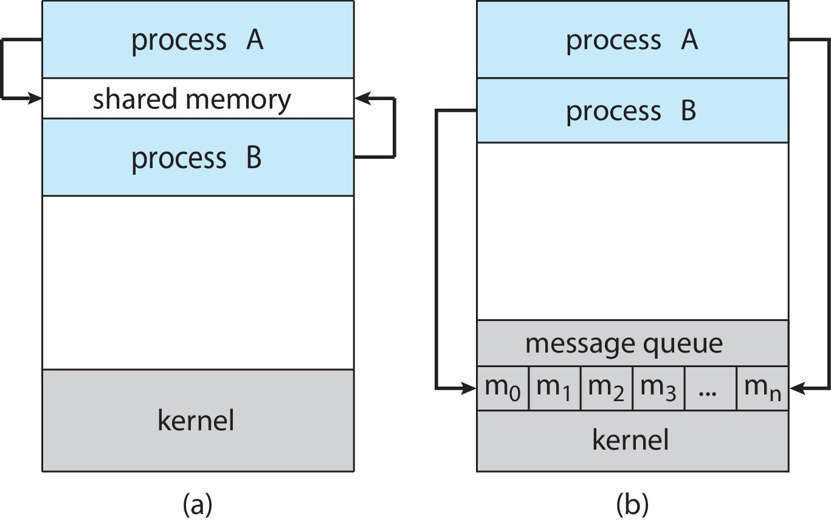
Communications Models
Shared-memory model
A region of memory that is shared by the cooperating processes is established. Processes can then exchange information by reading and writing data to the shared region.
Fig: Shared memory

Slide 6
Communications Models
Message-passing model
Communication takes place by means of messages exchanged between the cooperating processes.
Message passing is useful for exchanging smaller amounts of data.
Message passing is also easier to implement in a distributed system than shared memory.
Fig: Message passing

Slide 7
Communications Models
Shared memory can be faster than message passing, since message-passing systems are implemented using system calls, and thus require the more time-consuming task of kernel intervention.
In shared-memory systems, system calls are required only to establish shared memory regions. Once shared memory is established, all accesses are treated as routine memory accesses, and no assistance from the kernel is required.
Fig: (a) Shared memory (b) Message passing

Slide 8
Interprocess Communication (IPC)
Name any IPC method
Pipes
Known only to processes which are descendants of the process
Signals

Slide 9
IPC-operations
Processes communicate with each other without resorting to shared variables.
Another way to achieve the same effect for cooperating processes to communicate with each other via a message-passing facility.
For example, an Internet chat program could be designed so that chat participants communicate with one another by exchanging messages.
IPC facility provides two operations:
Send (message)
Receive (message)
The message size is either fixed or variable

Slide 10
IPC in Shared-Memory Systems
The producer–consumer problem,
A common paradigm for cooperating processes.
Exchange information by reading and writing data in the shared areas.
To allow producer and consumer processes to run concurrently, requirements?
A buffer of items
Filled by the producer
Emptied by the consumer
This buffer will reside in a region of memory that is shared by the producer and consumer processes.
The producer and consumer must be synchronized, why?
The consumer does not try to consume an item that has not yet been produced.

Slide 11
IPC in Shared-Memory Systems
Two types of buffers can be used:
Unbounded-buffer places no practical limit on the size of the buffer:
Producer never waits
Consumer waits if there is no buffer to consume
Bounded-buffer assumes, there is a fixed buffer size
Producer must wait if all buffers are full
Consumer waits if there is no buffer to consume

Slide 12
Bounded-Buffer – Shared-Memory Solution
Shared data
#define BUFFER_SIZE 10
typedef struct {
. . .
} item;
item buffer[BUFFER_SIZE];
int in = 0;
int out = 0;
The shared buffer is implemented as a circular array with two logical pointers: in and out.
The variable in points to the next free position in the buffer;
The variable out points to the first full position in the buffer.

Slide 13
Bounded-Buffer – Shared-Memory Solution
item next_produced;
while (true) {
/* produce an item in next produced */
while (((in + 1) % BUFFER_SIZE) == out)
; /* do nothing */
buffer[in] = next_produced;
in = (in + 1) % BUFFER_SIZE;
}
The buffer is empty when in == out;
The buffer is full when ((in + 1) % BUFFER SIZE) == out.
item next_consumed;
while (true) { while (in == out)
; /* do nothing */ next_consumed = buffer[out];
out = (out + 1) % BUFFER_SIZE; /* consume the item in next consumed */
}
The variable in points to the next free position in the buffer; out points to the first full position in the buffer.

Slide 14
Bounded-Buffer – Shared-Memory Solution
Our original solution allowed at most BUFFER_SIZE − 1 items in the buffer at the same time.
One more solution could be
To add an integer variable, count, initialized to 0.
Count is incremented every time we add a new item to the buffer and is decremented every time we remove one item from the buffer.

Slide 15
Bounded-Buffer – Shared-Memory Solution
item next_produced;
while (true) { /* produce an item in next produced */
while (count == BUFFER_SIZE)
; /* do nothing */
buffer[in] = next_produced;
in = (in + 1) % BUFFER_SIZE;
count++;
}
item next_consumed;
while (true) {
while (count == 0)
; /* do nothing */
next_consumed = buffer[out];
out = (out + 1) % BUFFER_SIZE;
count--;
/* consume the item in next consumed */
}

Slide 16
Bounded-Buffer – Shared-Memory Solution
Although the producer and consumer routines shown are correct separately, they may not function correctly when executed concurrently.
Suppose that the value of the variable count is currently 5 and that the producer and consumer processes concurrently execute the statements count++ and count—.
Following the execution of these two statements, the value of the variable count may be 4, 5, or 6. The only correct result, though, is count == 5

Slide 17
Bounded-Buffer – Shared-Memory Solution
count++ could be implemented as (Producer ) register1 = count register1 = register1 + 1 count = register1
count-- could be implemented as (Consumer ) register2 = count register2 = register2 - 1 count = register2
Consider this execution interleaving with “count = 5” initially:
S0: producer execute register1 = count {register1 = 5} S1: producer execute register1 = register1 + 1 {register1 = 6} S2: consumer execute register2 = count {register2 = 5} S3: consumer execute register2 = register2 – 1 {register2 = 4} S4: producer execute count = register1 {count = 6 } S5: consumer execute count = register2 {count = 4}
If, we reversed the order of the statements at S4 and S5, we would arrive at the incorrect state count= 6.

Slide 18
Race Condition
When two or more process cooperates with each other, manipulate the same data concurrently and the outcome of the execution depends on the particular order in which the access takes place, is called a race condition.
Such processes need to be synchronized so that their order of execution can be guaranteed.
The procedure involved in preserving the appropriate order of execution of cooperative processes is known as Process Synchronization.

Slide 19
IPC- Unix System V
In Unix System V:
Messages allow processes to send formatted data streams to arbitrary processes
Shared memory allows processes to share parts of their virtual address space
Semaphores allow processes to synchronize execution.
Implemented as a unit

Slide 20
IPC- Unix System V
Each mechanism contains a table whose entries describe all instances of the mechanism.
Each entry contains a numeric key, which is its user-chosen name.

Slide 21
IPC- Unix System V
Each mechanism contains a "get" system call to create a new entry or to retrieve an existing one, and the parameters to the calls include a key and flags.
The kernel searches the proper table for an entry named by the key.
Processes can call the "get" system calls with the key IPC_PRIVATE to assure the return of an unused entry.
They can set the IPC_CREAT bit in the flag field to create a new entry if one by the given key does not already exist, and they can force an error notification by setting the IPC_EXCL and IPC_CREAT flags, if an entry already exists for the key.
The "get" system calls return a kernel-chosen descriptor for use in the other system calls

Slide 22
IPC- Unix System V
For each IPC mechanism, the kernel uses the following formula to find the index into the table of data structures from the descriptor:
index = descriptor modulo (number of entries in table)
For example, if the table of message structures contains 100 entries,
The descriptors for entry 1 are 1, 101 , 201 , and so on.

Slide 23
IPC- Unix System V
When a process removes an entry,
The kernel increments the descriptor associated with it by the number of entries in the table
The incremented value becomes the new descriptor for the entry when it is next allocated by a "get" call.
Processes that attempt to access the entry by its old descriptor fail on their access.
Referring to the previous example, if the descriptor associated with message entry 1 is 201 when it is removed, the kernel assigns a new descriptor, 301 , to the entry.
Processes that attempt to access descriptor 201 receive an error, because it is no longer valid. The kernel eventually recycles descriptor numbers, presumably after a long time lapse.

Slide 24
IPC- Unix System V
Each IPC entry has a permissions structure that includes
The user ID and
group ID of the process that created the entry,
A user and group ID set by the "control" system call, and
A set of read-write-execute permissions for user, group, and others, similar to the file permission modes.

Slide 25
IPC- Unix System V
Each entry contains other status information, such as
The process ID of the last process to update the entry {send a message, receive a message, attach shared memory, and so on) , and
The time of last access or update.

Slide 26
IPC- Unix System V
Each mechanism contains a "control" system call
To query status of an entry,
To set status information, or
To remove the entry from the system.
When a process queries the status of an entry,
The kernel verifies that the process has read permission and
Then copies data from the table entry to the user address.

Slide 27
IPC- Unix System V
To set parameters on an entry,
The kernel verifies that
User ID of the process matches the user ID or the creator user ID of the entry or
The process is run by a superuser; Write permission is not sufficient to set parameters.
The kernel copies the user data into the table entry,
Setting the user ID, group ID, permission modes, and other fields dependent on the type of mechanism.
The kernel does not change the creator user and group ID fields, so the user who created an entry retains control rights to it.
Finally, a user can remove an entry if it is the superuser or if its process ID matches either ID field in the entry structure.
The kernel increments the descriptor number so that the next instance of assigning the entry will return a different descriptor.
System calls will fail if a process attempts to access an entry by an old descriptor.

Slide 28
IPC- Unix System V: Messages
There are four system calls for messages:
msgget returns (and possibly creates)
A message descriptor that designates a message queue for use in other system calls
msgctl
To set and return parameters associated with a message descriptor and an option to remove descriptors
msgsnd
Sends a message, and
msgrcv
Receives a message
https://tldp.org/LDP/lpg/node34.html

Slide 29
IPC- Unix System V: Messages
The syntax of the msgget system call is
msgqid = msgget (key, flag) ;
where
msgqid is the descriptor returned by the call, and
key and flag have the semantics as for the general "get" calls.
The kernel stores messages on a linked list (queue) per descriptor, and it uses msgqid as an index into an array of message queue headers.

Slide 30
IPC- Unix System V: Messages
In addition, the queue structure contains the following fields
Pointers to the first and last messages on a linked list;
The number of messages and the total number of data bytes on the linked list;
The maximum number of bytes of data that can be on the linked list;
The process IDs of the last processes to send and receive messages;
Time stamps of the last msgsnd, msgrcv, and msgctl operations.

Slide 31
IPC- Unix System V: Messages
When a user calls msgget to create a new descriptor, the kernel searches the array of message queues to see if one exists with the given key.
If there is no entry for the specified key, the kernel allocates a new queue structure, initializes it, and returns an identifier to the user.
Otherwise, it checks permissions and returns

Slide 32
IPC- Unix System V: Messages
A process uses the msgsnd system call to send a message:
msgsnd (msgqid, msg, size, flag) ;
where
msgqid is the descriptor of a message queue typically returned by a msgget call,
msg is a pointer to a structure consisting of a user chosen integer type and a character array,
size gives the size of the data array, and
flag specifies the action the kernel should take if it runs out of internal buffer space
The flag argument can be set to 0 (ignored), or IPC_NOWAIT

Slide 33
IPC- Unix System V: Messages
The kernel checks that
The sending process has write permission for the message descriptor,
The message length does not exceed the system limit,
The message queue does not contain too many bytes, and
The message type is a positive integer.

Slide 34
IPC- Unix System V: Messages
If all tests succeed, the kernel
Allocates space for the message from a message map and
Copies the data from user space.
Allocates a message header
Puts it on the end of the linked list of message headers for the message queue.
It records
The message type and
Size in the message header,
Sets the message header to point to the message data, and updates various statistics fields (number of messages and bytes on queue, time stamps and process ID of sender) in the queue header.

Slide 35
IPC- Unix System V: Messages
The kernel then awakens processes that were asleep, waiting for messages to arrive on the queue.
If the number of bytes on the queue exceeds the queue's limit, the process sleeps until other messages are removed from the queue.
If the process specified not to wait (flag IPC_NOWAIT), however, it returns immediately with an error indication

Slide 36
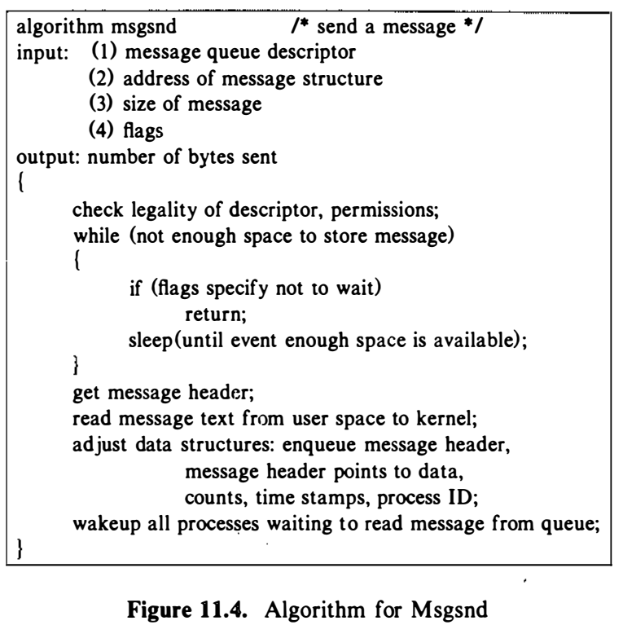
IPC- Unix System V: Messages

Slide 37
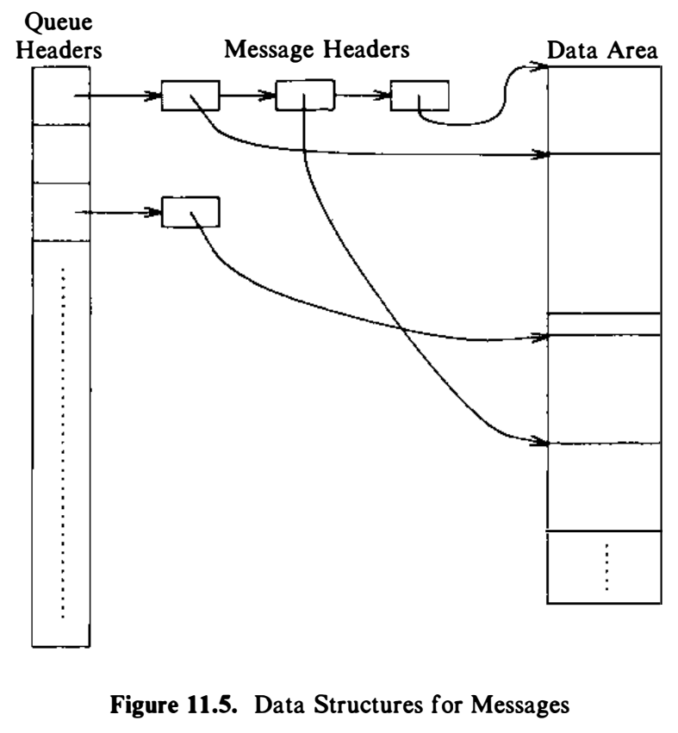
IPC- Unix System V: Messages
Depicts messages on a queue, showing queue headers, linked lists of message headers, and pointers from the message headers to a data area.

Slide 38
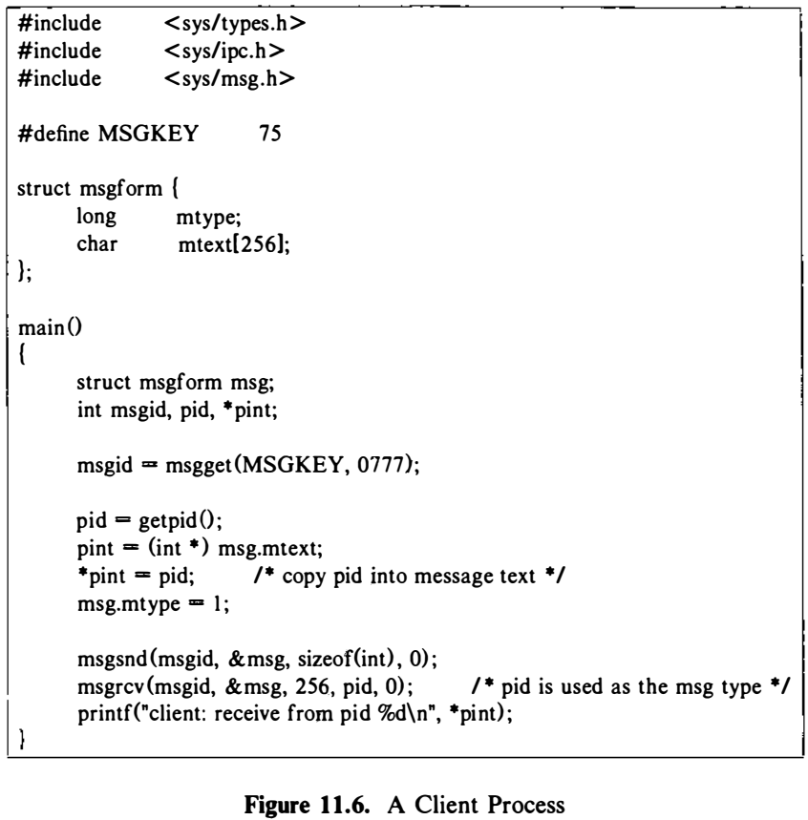
IPC- Unix System V: Messages
A process calls msgget to get a descriptor for MSGKEY.
It sets up a message of length 256 bytes, although it uses only the first integer,
Copies its process ID into the message text,
Assigns the message type value 1, then calls msgsnd to send the message.

Slide 39
IPC- Unix System V: Messages
A process receives messages by
count = msgrcv(id, msg, maxcount, type, flag) ;
where
id is the message descriptor,
msg is the address of a user structure to contain the received message,
maxcount is the size of the data array in msg,
type specifies the message type the user wants to read, and
flag specifies what the kernel should do if no messages are on the queue.
The return value, count, is the number of bytes returned to the user.

Slide 40
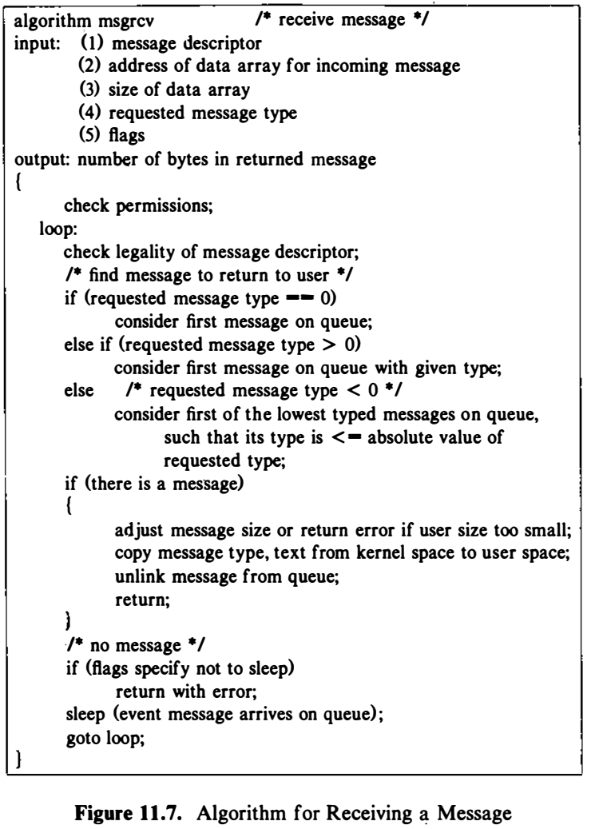
IPC- Unix System V: Messages
The kernel checks that the user has the necessary access rights to the message queue.
If the requested message type is 0, the kernel finds the first message on the linked list.
If its size is less than or equal to the size requested by the user, the kernel copies the message data to the user data structure and adjusts its internal structures appropriately:
It decrements the count of messages on the queue and
The number of data bytes on the queue,
Sets the receive time and receiving process ID,
Adjusts the linked list, and
Frees the kernel space that had stored the message data.
If processes were waiting to send messages because there was no room on the list, the kernel awaken them.
If the message is bigger than maxcount specified by the user, the kernel returns an error for the system call and leaves the message on the queue.
If the process ignores size constraints, however (bit MSG_NOERROR is set in flag), the kernel truncates the message, returns the requested number of bytes, and removes the entire message from the list.

Slide 41
IPC- Unix System V: Messages
Message Type
A process can receive messages of a particular type by setting the type parameter appropriately.
If it is a positive integer, the kernel returns the first message of the given type.
If it is negative, the kernel finds the lowest type of all messages on the queue, provided it is less than or equal to the absolute value of type, and returns the first message of that type.
For example, if a queue contains three messages whose types are 3, 1, and 2, respectively, and a user requests a message with type -2, the kernel returns the message of type 1.
In all cases, if no messages on the queue satisfy the receive request, the kernel puts the process to sleep, unless the process had specified to return immediately by setting the IPC_NOWAIT bit in flag.

Slide 42
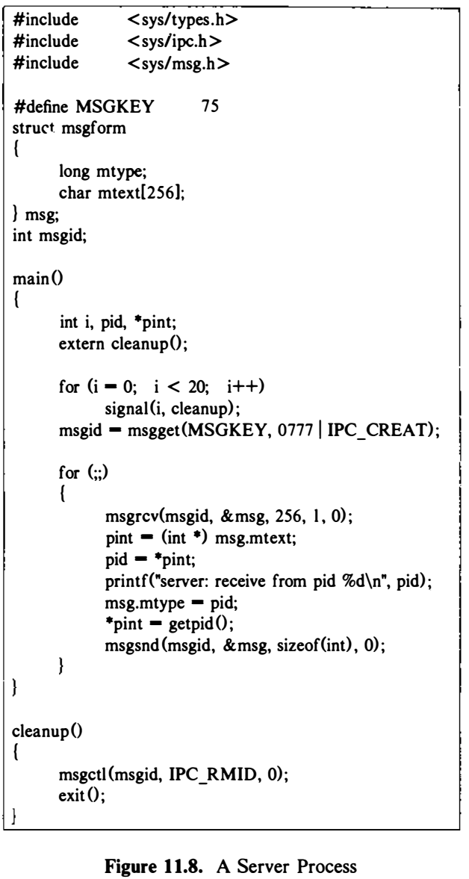
IPC- Unix System V: Messages
Client-Server Communication
Server may receive requests from client processes to provide information from a database; the server process is a single point of access to the database, making consistency and security easier.
The server creates a message structure by setting the IPC_CREAT flag in the msgget call and receives all messages of type 1 - requests from client processes.
It reads the message text, finds the process ID of the client process, and sets the return message type to the client process ID.
Here, it sends its process ID back to the client process in the message text, and the client process receives messages whose message type equals its process ID.
Thus, the server process receives only messages sent to it by client processes, and client processes receive only messages sent to them by the server.
The processes cooperate to set up multiple channels on one message queue.
The process catches signals and calls the function cleanup to remove the message queue from the system

Slide 43
IPC- Unix System V: Messages

Slide 44
IPC- Unix System V: Messages
A process can query
The status of a message descriptor,
Set its status, and
Remove a message descriptor
The syntax of the call is
msgctl(id, cmd, mstatbuf)
where
id identifies the message descriptor,
cmd specifies the type of command, and
mstatbuf is the address of a user data structure that will contain control parameters or the results of a query.

Slide 45
IPC- Unix System V: Shared Memory
Process communicate directly with each other by sharing parts of their virtual address space and then reading and writing the data stored in the shared memory.
System calls
shmget system call
Creates a new region of shared memory or returns an existing one
shmat system call
Logically attaches all region to the virtual address space of a process

Slide 46
IPC- Unix System V: Shared Memory
shmdt system call
Detaches a region from the virtual address space of a process
shmctl system call
Manipulates various parameters associated with the shared memory.
Processes read and write shared memory using the same machine instructions they use to read and write regular memory.
After attaching shared memory, it becomes part of the virtual address space of a process, accessible in the same way other virtual addresses are; no system calls are needed to access data in shared memory.

Slide 47
IPC- Unix System V: Shared Memory
The syntax of the shmget system call is
shmid = shmget (key, size, flag) ;
where size is the number of bytes in the region.
The kernel searches the shared memory table for the given key
If it finds an entry and the permission modes are acceptable, it returns the descriptor for the entry.
If it does not find an entry and the user had set the IPC_CREAT flag to create a new region, the kernel verifies that the size is between system-wide minimum and maximum values and then allocates a region data structure using algorithm allocreg.

Slide 48
IPC- Unix System V: Shared Memory
The kernel saves the permission modes, size, and a pointer to the region table entry in the shared memory table and sets a flag there to indicate that no memory is associated with the region.
It allocates memory (page tables and so on) for the region only when a process attaches the region to its address space.
Kernel also sets a flag on the region table entry to indicate that the region should not be freed when the last process attached to it exits.
Data in shared memory remains intact even though no processes include it as part of their virtual address space

Slide 49
IPC- Unix System V: Shared Memory
shmat system call
A process attaches a shared memory region to its virtual address space
virtaddr = shmat(id, addr, flags);
Id, returned by a previous shmget system call, identifies the shared memory region,
addr is the virtual address where the user wants to attach the shared memory, and
flags specify whether the region is read-only and whether the kernel should round off the user-specified address.
The return value, virtaddr, is the virtual address where the kernel attached the region, not necessarily the value requested by the process.

Slide 50
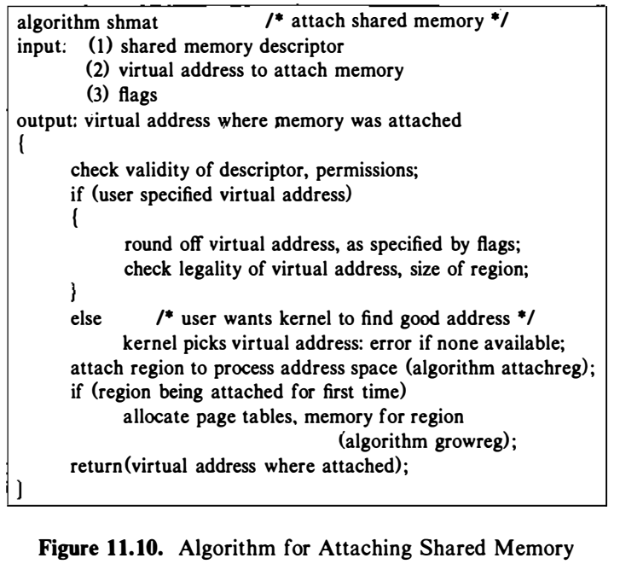
IPC- Unix System V: Shared Memory
When executing the shmat system call, the kernel verifies that the process has the necessary permissions to access the region.
It examines the address the user specifies: If 0, the kernel chooses a convenient virtual address
The shared memory must not overlap other regions in the process virtual address space
For instance, a process can increase the size of its data region with the brk system call, and the new data region is virtually contiguous with the previous data region; therefore, the kernel should not attach a shared memory region close to the data region.
Similarly, it should not place shared memory close to the top of the stack so that the stack will not grow into it. For example, if the stack grows towards higher addresses
The best place for shared memory is immediately before the start of the stack region

Slide 51
IPC- Unix System V: Shared Memory
The kernel checks that the shared memory region fits into the process address space and attaches the region, using algorithm attachreg.
If the calling process is the first to attach the region, the kernel allocates the necessary tables, using algorithm growreg, adjusts the shared memory table entry field for "last time attached," and returns the virtual address at which it attached the region.

Slide 52
IPC- Unix System V: Shared Memory
A process detaches a shared memory region from its virtual address space by
shmdt (addr)
where addr is the virtual address returned by a prior shmat call.
The kernel searches for the process region attached at the indicated virtual address and detaches it from the process address space, using algorithm detachreg.
Because the region tables have no back pointers to the shared memory table, the kernel searches the shared memory table for the entry that points to the region and adjusts the field for the time the region was last detached.

Slide 53
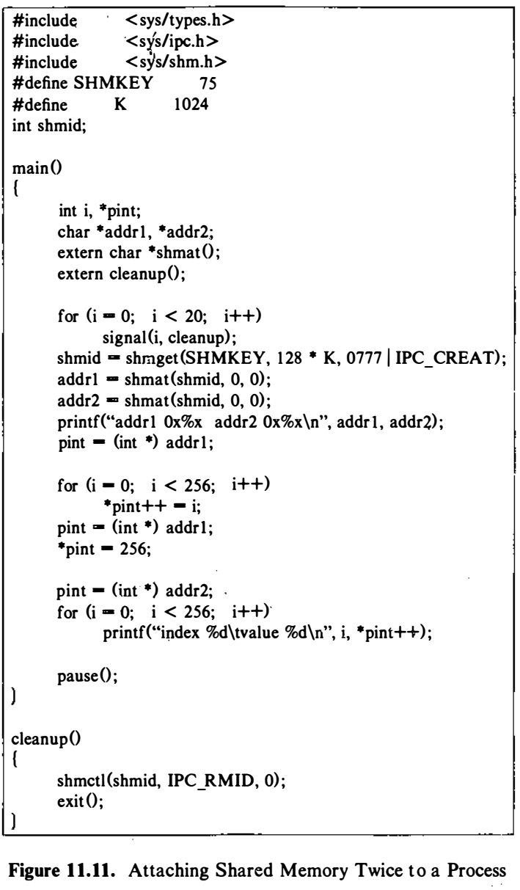
IPC- Unix System V: Shared Memory
A process creates a 128 K-byte shared memory region
Attaches it twice to its address space at different virtual addresses.
It writes data in the "first" shared memory and reads it from the ''second" shared memory.

Slide 54
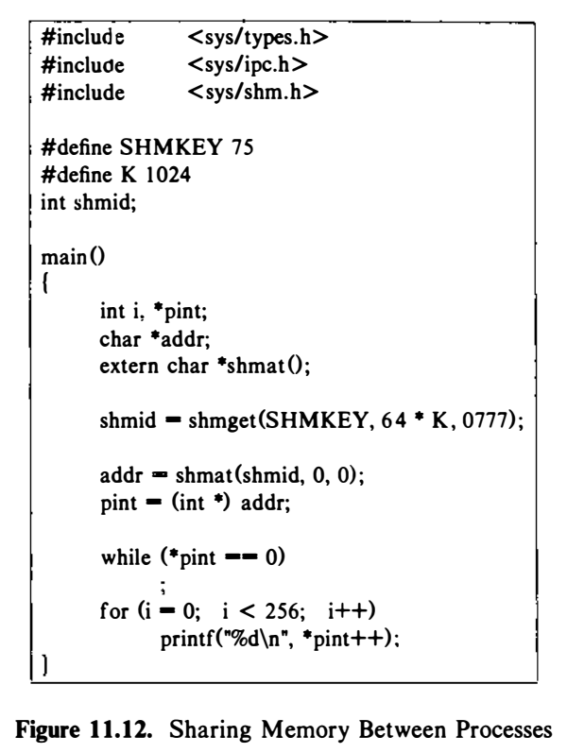
IPC- Unix System V: Shared Memory
Figure 11.12 shows another process attaching the same region {it gets only 64K bytes, to show that each process can attach different amounts of a shared memory region) ; it waits until the first process writes a nonzero value in the first word of the shared memory region and then reads the shared memory.
The first process pauses to give the second process a chance to execute; when the first process catches a signal, it removes the shared memory region

Slide 55
IPC- Unix System V: Shared Memory
A process uses the shmctl system call to query status and set parameters for the shared memory region:
shmctl (id, cmd, shmstatbuf) ;
Id identifies the shared memory table entry, cmd specifies the type of operation, and shmstatbuf is the address of a user-level data structure that contains the status information of the shared memory table entry when querying or setting its status.
The kernel treats the commands for querying status and changing owner and permissions similar to the implementation for messages.

Slide 56
IPC- Unix System V: Shared Memory
When removing a shared memory region, the kernel frees the entry and looks at the region table entry:
If no process has the region attached to its virtual address space, it frees the region table entry and all its resources, using algorithm freereg.
If the region is still attached to some processes (its reference count is greater than 0), the kernel just clears the flag that indicates the region should not be freed when the last process detaches the region.
Processes that are using the shared memory may continue doing so, but no new processes can attach it. When all processes detach the region, the kernel frees the region.
This is analogous to the case in the file system where a process can open a file and continue to access it after it is unlinked

Slide 57
IPC- Unix System V: Semaphore
Before Semaphore:
A process would create a lock file with the creat system call if it wanted to lock a resource.
The creat fails if the file already exists, and the process would assume that another process had the resource locked.
The major disadvantages
The process does not know when to try again, and
Lock files may inadvertently be left behind when the system crashes or is rebooted.
Solution:
Dekker algorithm, proposed by Dijkstra that describes an implementation of semaphores
Allow processes to synchronize execution by doing a set of operations atomically on a set of semaphores

Slide 58
IPC- Unix System V: Semaphore
Dekker algorithm
Integer-valued objects
Two atomic operations: P and V
P operation decrements the value of a semaphore if its value is greater than 0,
V operation increments its value.
The operations are atomic
At most one P or V operation can succeed on a semaphore at any time.
The kernel does all the operations atomically;
No other processes adjust the semaphore values until all operations are done.

Slide 59
IPC- Unix System V: Semaphore
The semaphore system calls in System V are a generalization of Dijkstra's P and V operations.
A semaphore in UNIX System V consists of the following elements:
The value of the semaphore,
The process ID of the last process to manipulate the semaphore
The number of processes waiting for the semaphore value to increase,
The number of processes waiting for the semaphore value to equal 0.

Slide 60
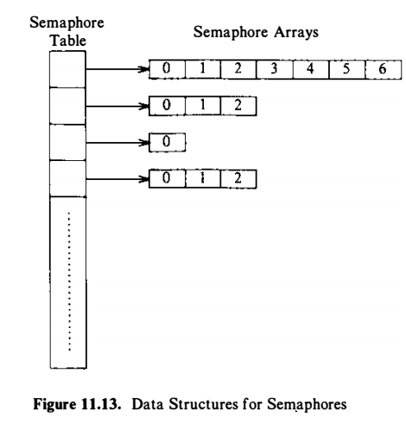
IPC- Unix System V: Semaphore

Slide 61
IPC- Unix System V: Semaphore
The semaphore system calls are
semget to create and gain access to a set of semaphores,
semctl to do various control operations on the set, and
semop to manipulate the values of semaphores.

Slide 62
IPC- Unix System V: Semaphore
Semget
int semid = semget(key_t key, int nsems, int flag);
key
if key is set to IPC PRIVATE, new semaphore is created
if no semaphore corresponding to this key value exists and IPC CREAT is asserted in flag, new semaphore is created
otherwise, integer identifier for the existing semaphore corresponding to key is returned
nsems
# of semaphores to be created i.e. the kernel allocates an entry that points to an array of semaphore structures with count elements
0 if existing semaphore is being used
flag
specifies permissions, whether semaphore is to be created, etc

Slide 63
IPC- Unix System V: Semaphore
semop
int semop(int semid, struct sembuf *ops, size_t nops);
ops
a pointer to an array of semaphore operations, and count is the size of the array
struct sembuf {
ushort sem_num; // which semaphore (0 .. nsems-1), the semaphore number identifying the semaphore array entry being operated on
short sem_op;
short sem_flg; // specifies IPC_NOWAIT, SEM_UNDO, etc.
}
sem_op > 0 add this value to semval (≡ unlocking / returning resources)
sem_op < 0 subtract this value from semval (≡ obtaining resources)
IPC_NOWAIT (no blocking) ⇒ return -1 (error)
otherwise, semncnt is incremented and process blocks until semval >= |sem_op|
sem_op == 0 wait till semval == 0 (as above)

Slide 64
IPC- Unix System V: Semaphore
semctl
int semctl(int semid, int semnum, int cmd, union semun arg);
semnum
specifies which semaphore is to be operated on (0 .. nsems-1)
cmd
GETVAL gets the value of sem base[semnum].semval
SETVAL sets the value of sem base[semnum].semval to arg.val
GETALL, SETALL operates on all semaphores using arg.array
arg
specifies values used by various operations
union semun {
int val;
ushort *array;
struct semid ds *buf;
}

Slide 65
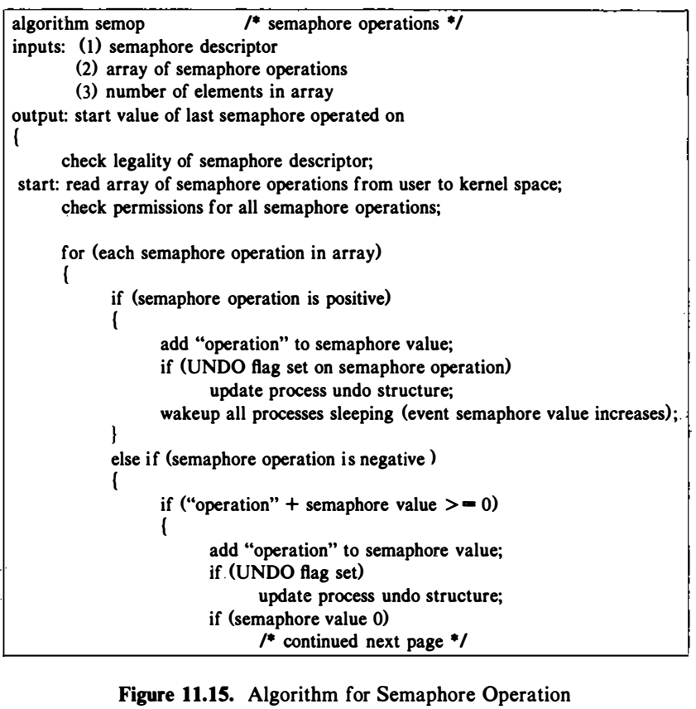
IPC- Unix System V: Semaphore
The kernel reads the array of semaphore operations from the user address space and verifies that the semaphore numbers are legal and that the process has the necessary permissions to read or change the semaphores.
If permission is not allowed, the system call fails.
The kernel changes the value of a semaphore according to the value of the operation.
If positive, it increments the value of the semaphore and awakens all processes that are waiting for the value of the semaphore to increase.

Slide 66
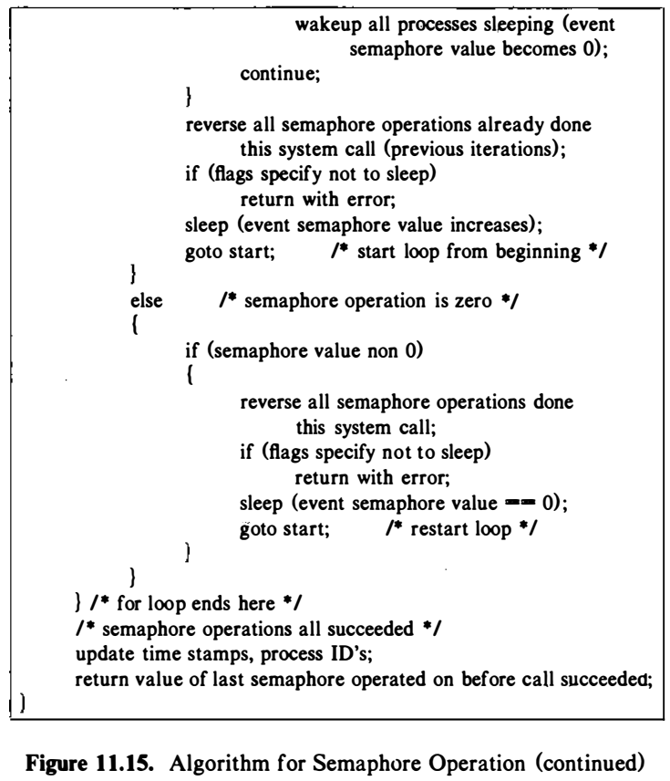
IPC- Unix System V: Semaphore
If the semaphore operation is 0, the kernel checks the semaphore value: If 0, it continues with the other operations in the array; otherwise, it increments the number of processes asleep, waiting for the semaphore value to be 0, and goes to sleep.
If the semaphore operation is negative and its absolute value is less than or equal to the value of the semaphore, the kernel adds the operation value (a negative number) to the semaphore value.
If the result is 0, the kernel awakens all process asleep waiting for the semaphore value to be 0.
If the value of the semaphore is less than the absolute value of the semaphore operation, the kernel puts the process to sleep on the event that the value of the semaphore increases.

Slide 67
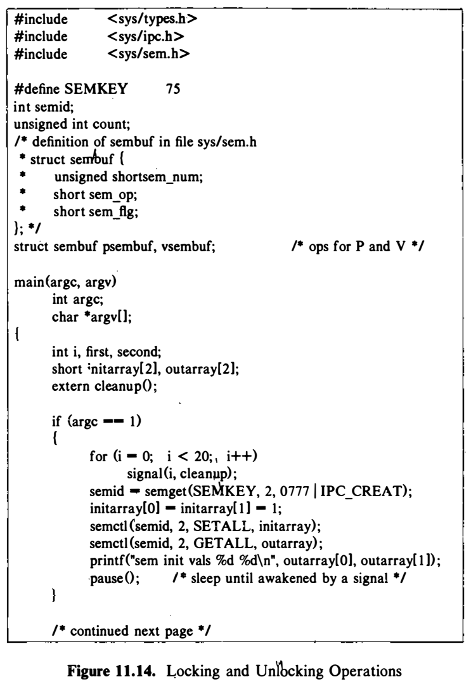
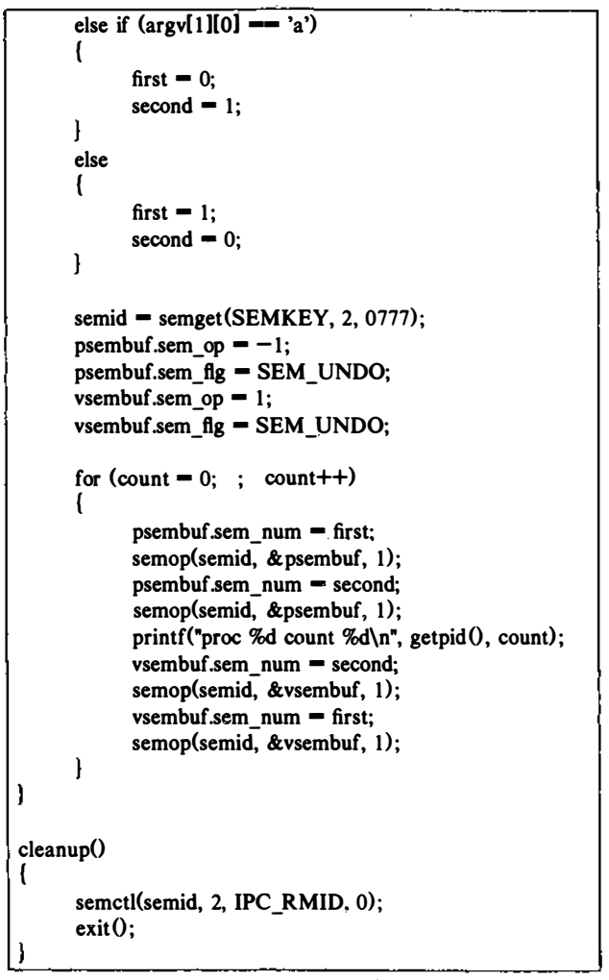
IPC- Unix System V: Semaphore
Execution:
CASE I:
a.out &
The process creates a semaphore set with two elements and initializes their values to 1.
Then, it pauses and sleeps until awakened by a signal, when it removes the semaphore in cleanup.

Slide 68
IPC- Unix System V: Semaphore
Execution:
CASE II:
a.out a &
It decrements the value of semaphore 0, decrements the value of semaphore 1 , executes the print statement, and then increments the values
of semaphores 1 and 0.
A process goes to sleep if it attempts to decrement the
value of a semaphore that is 0, and hence the semaphore is considered locked: Because the semaphores were initialized to 1 and no other processes are using the semaphores, process A will never sleep, and the semaphore values will oscillate
between 1 and 0.

Slide 69
IPC- Unix System V: Semaphore
Execution:
CASE III:
a.out b &
The process (B) decrements semaphores 0 and 1 in the opposite order from process A.

Slide 70
IPC- Unix System V: Semaphore
When processes A and B run simultaneously, a situation could arise whereby process A has locked semaphore 0 and wants to lock semaphore 1 , but process B has locked semaphore 1 and wants to lock semaphore 0. Both processes sleep, unable to continue. They are deadlocked and exit only on receipt of a signal.
Solution:
Processes can do multiple semaphore operations simultaneously

Slide 71
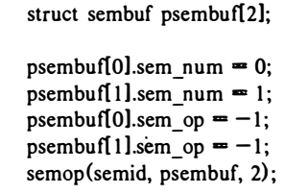
IPC- Unix System V: Semaphore
psembuf is an array of semaphore operations that decrements semaphores 0 and 1 simultaneously.
If either operation cannot succeed, the process sleeps until they both succeed.
For instance, if the value of semaphore 0 is 1 and the value of semaphore 1 is 0, the kernel would leave the values intact until it can decrement both values

Slide 72
IPC- Unix System V: Semaphore
IPC _NOWAIT flag
if the kernel arrives at a situation where the process would sleep because it must wait for the semaphore value to exceed a particular value or for it to have value 0, the kernel returns from the system call with an error condition.
Thus, it is possible to implement a conditional semaphore, whereby a process does not sleep if it cannot do the atomic action.

Slide 73
IPC- Unix System V: Semaphore
Scenario: If a process does a semaphore operation, presumably locking some resource, and then exits without resetting the semaphore value.
Other processes would find the semaphore locked even though the process that had locked it no longer exists.
Solution
A process can set the SEM_UNDO flag in the semop call;
When it exits, the kernel reverses the effect of every semaphore operation the process had done.
To implement this feature, the kernel maintains a table (undo structures) with one entry for every process in the system.

Slide 74
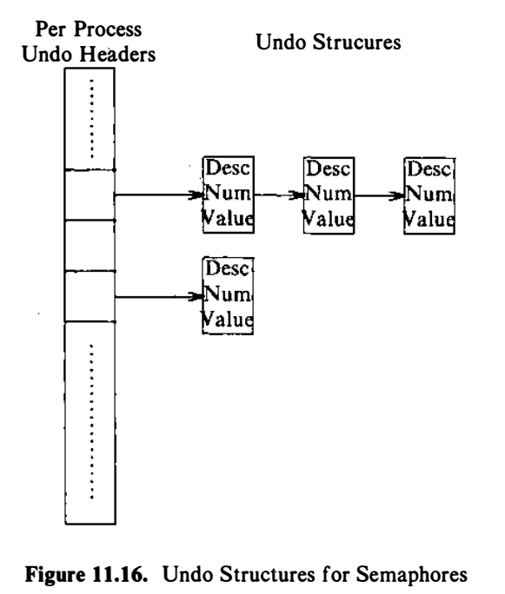
IPC- Unix System V: Semaphore
Each entry points to a set of undo structures, one for each semaphore used by the process.
Each undo structure is an array of triples consisting of
A semaphore ID,
A semaphore number in the set identified by ID, and
An adjustment value.
The kernel allocates undo structures dynamically when a process executes its first semop system call with the SEM_UNDO flag set

Slide 75
IPC- Unix System V: Semaphore
On subsequent semop system calls with the SEM_UNDO flag set,
The kernel searches the process undo structures for one with the same semaphore ID and number as the semop operation:
If it finds one, it subtracts the value of the semaphore operation from the adjustment value.
The undo structure contains a negated summation of all semaphore operations the process had done on the semaphore for which the SEM_UNDO flag was set.
If no undo structure for the semaphore exists, the kernel creates one, sorting a list of structures by semaphor lD and number.
If an adjustment value drops to 0, the kernel removes the undo structure.
When a process exits, the kernel calls a special routine that goes through the undo structures associated with the process and does the specified action on the indicated semaphore

Slide 76
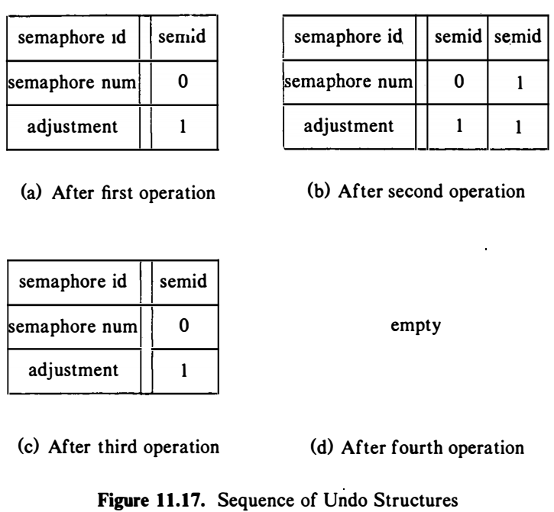
IPC- Unix System V: Semaphore
Figure shows the sequence when invoking the program with parameter ‘a’.
After the first operation, the process has one triple for semid with semaphore number 0 and adjustment value 1, and after the second operation, it has a second triple with semaphore number 1 and adjustment value 1.
If the process were to exit suddenly now, the kernel would go through the triples and add the value 1 to each semaphore, restoring their values to 0.

Slide 77
Assignment
Implement Producer-consumer Problem using
Message
Shared
Semaphore
Driver code:
Menu driven
Customer
Producer

Slide 78
Reference
The Design of the UNIX Operating System, by Maurice J. Bach

